Slide 1
WASH in Schools
HONDURAS
Rotary Club of Concord, CA

Slide 2
Program Design
Provide comprehensive WASH infrastructure to 30 schools.
Provide new WASH curriculum
6 Year program with three overlapping Global Grants (Phases) each of 2 year duration.

Slide 3
How To Perform M & E
International Partner & Host club
Parent Groups
Teachers
Community entities

Slide 4
Community Involvement
Local Rotary Clubs
Parent Groups
Teachers
Water Committees
Local municipalities
Ministry of Education etc.

Slide 5
International Partner
3 Annual site visits
Participation in workshops
Interviews with all agencies
Weekly business meeting via Skype
Weekly review of data
Monthly financial review

Slide 6
HOST CLUB
Liaison with all Community entities
Select/hire Project Manager
Hire Accountant
Hire Community Coordinator
Assign Rotarians to each school
Complete monthly M & E site visit
Train Parent Groups in Data Collection
Facilitate workshops (3) annually
Arrange Teacher Training Workshops

Slide 7
PARENT GROUPS
Responsible for
Generating funding
Maintaining/repairing WASH infrastructure
Select 4 members for training in data collection (2x2)
Weekly site visits/data collect.
Attend 3 workshops annually

Slide 8
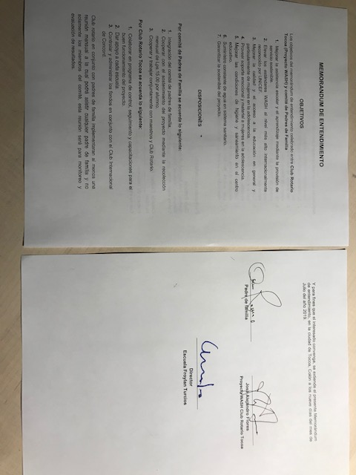

Slide 9
TEACHERS
Principal is surveyed weekly
Two teachers Female/Male are interviewed weekly
Prepare weekly WASH lesson notes
Teacher WASH Ambassador facilitates data collection.

Slide 10
Weekly Surveys

Slide 11
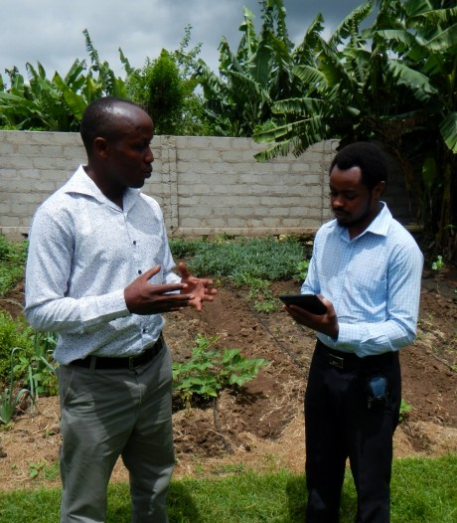
VARIABLES
Are all WASH hardware systems functioning
Breakages
Repairs
Soap available
Toilet paper
Chlorination
Cleaning of bathrooms daily
Teacher supervision of cleaning
Attendance/sick/menstruation
WASH curriculum being taught: frequency/class specifics
Fund collection (Parent Groups)
Etc.

Slide 14
Instruments
Deliver 18 workshops/focus groups for every community
Monitor & Evaluate project /data collection for 200 weeks.
Monitor & Evaluate Parent Groups for 50 months (Community Coordinator)

Slide 15
The END
Michael Barrington
Rotary Club of Concord CA, USA
majb7016@gmail.com

